Slide 1
Lecture 2
Trapezoid Rule

Slide 2


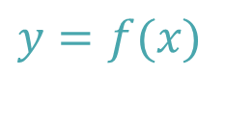



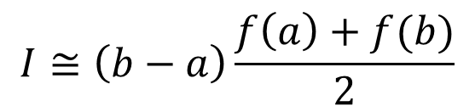




Introduction
The trapezoid rule is the closed two point Newton-Cote formula
$$y$$
$$y=f(x)$$
$$I=\int_{a}^{b}{f(x)dx}$$
$$y=P_{1}(x)$$
$$I≅\int_{a}^{b}{P_{1}(x)dx}$$
$$I≅\left(b−a\right)\frac{f\left(a\right)+f(b)}{2}$$
$$x$$
$$a$$
$$=x_{o}$$
$$b$$
$$=x_{1}$$
Notes:
In this lecture we present a first quadrature formula: the two point Newton-Cote formula
This formula is as well known as the trapezoid rule.
In the two point Newton-Cote formula we interpolate the function f to integrate in two points: the start and end point of the integration interval.
The resulting interpolation polynomial P1(x) is the line between the points (a, f(a) ) and (b, f(b) ).
The approximation of the defined integral over f(x) will be the surface below the interpolating polynomial P1(x).
As obvious from the graph, this surface is a trapezoid and it’s surface can be computed right away.
Consequently our defined integral I can be approximated as $\left(b−a\right)\frac{f\left(a\right)+f(b)}{2}$

Slide 3
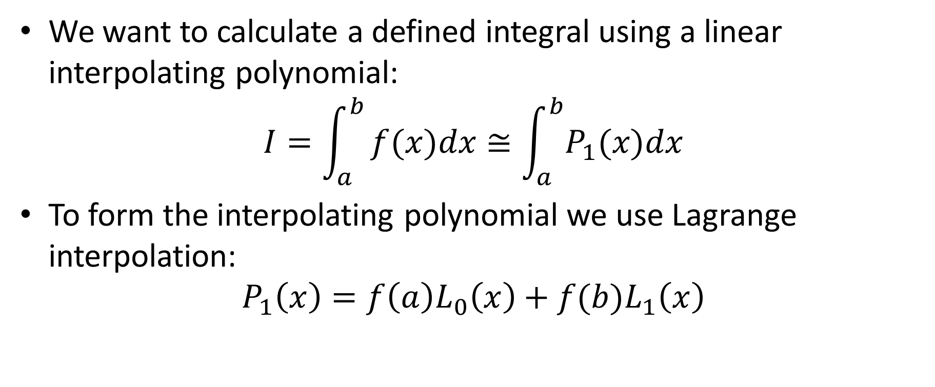
Proper Derivation
We want to calculate a defined integral using a linear interpolating polynomial:
$$I=\int_{a}^{b}{f(x)dx≅\int_{a}^{b}{P_{1}(x)dx}}$$
To form the interpolating polynomial we use Lagrange interpolation:
$$P_{1}\left(x\right)=f\left(a\right)L_{0}\left(x\right)+f(b)L_{1}\left(x\right)$$
Notes:
If the graphical derivation of the trapezoid rule is very useful for an intuitive understanding of the method, we still want to have a more systematic way. This more systematic way will be used in coming lectures to derive other quadrature formulas
For this we compute the interpolating polynomial P1(x) as a linear combination of two Lagrange polynomials Lo(x) and L1(x)

Slide 4
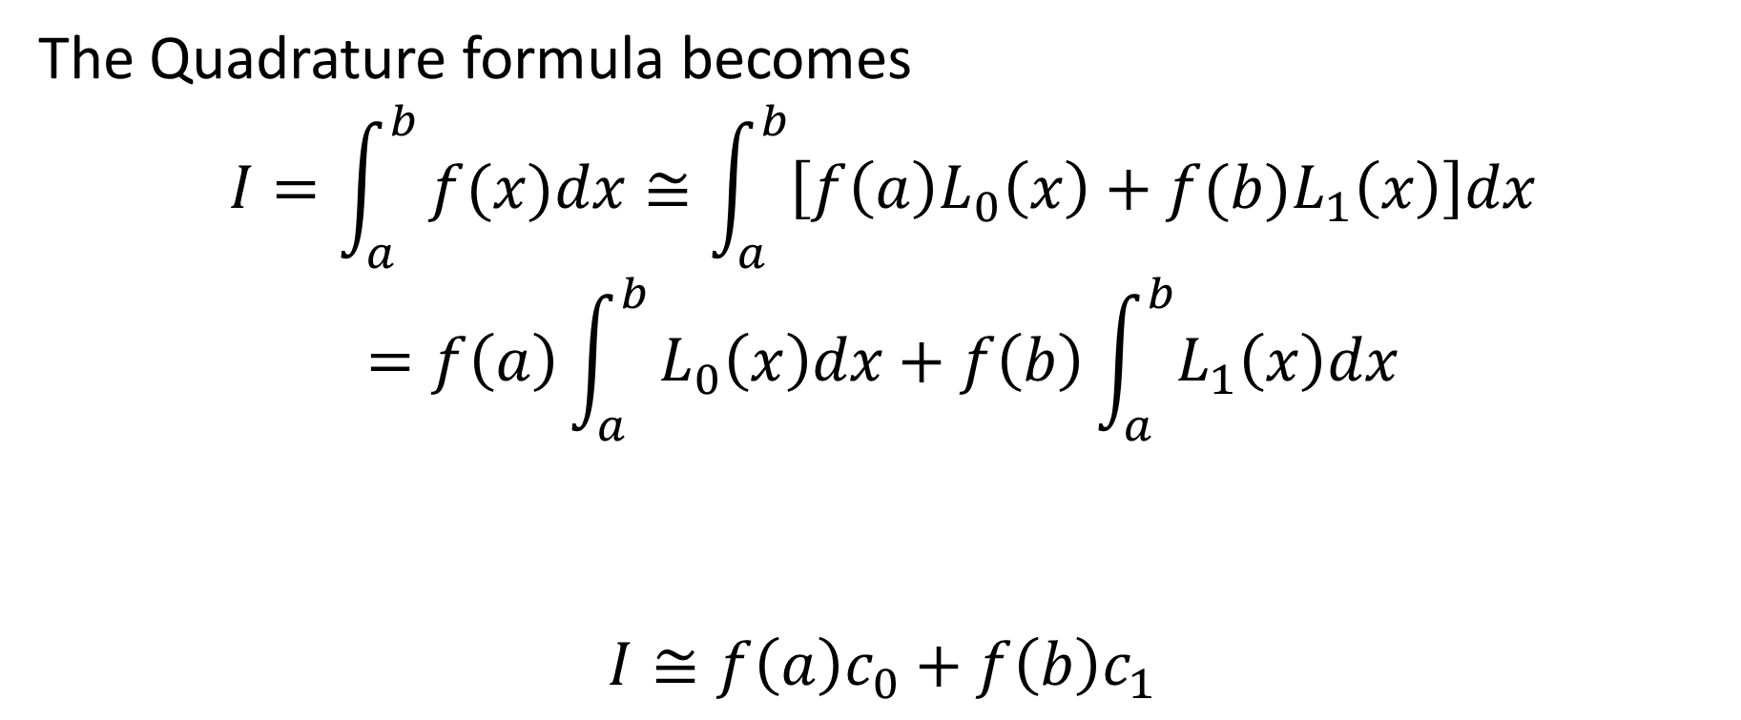


Proper Derivation
The Quadrature formula becomes
$$I=\int_{a}^{b}{f(x)dx≅\int_{a}^{b}{\left[f\left(a\right)L_{0}\left(x\right)+f(b)L_{1}\left(x\right)\right]dx}}$$
$$=f\left(a\right)\int_{a}^{b}{L_{0}\left(x\right)dx+f\left(b\right)\int_{a}^{b}{L_{1}\left(x\right)dx}}$$
$$I≅f\left(a\right)c_{0}+f\left(b\right)c_{1}$$
$$c_{0}$$
$$c_{1}$$
Notes:
To find the approximation of our defined integral we integrate the interpolating polynomial
As f(a) and f(b) are constants that do not depend on x, we can re-write our integral as a sum of two integrals over the two Lagrange polynomials
Calling these integrals co and c1 we obtain that our defined integral is given by $f\left(a\right)c_{0}+f\left(b\right)c_{1}$

Slide 5

Proper Derivation
To finalize the derivation we have to calculate the two coefficients $c_{0}$ and $c_{1}$:
$$c_{0}=\int_{a}^{b}{L_{0}\left(x\right)dx}$$
$$c_{1}=\int_{a}^{b}{L_{1}\left(x\right)dx}$$
Notes:
What remains to do is to compute these two coefficients c0 and c1 by integrating the Lagrange polynomials

Slide 6
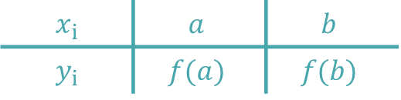


Lagrange Polynomials
The Lagrange polynomials are:
$$x_{i}$$ | $$a$$ | $$b$$
$$y_{i}$$ | $$f(a)$$ | $$f(b)$$
$$L_{0}\left(x\right)=\frac{x−b}{a−b}$$
$$L_{1}\left(x\right)=\frac{x−a}{b−a}$$
Notes:
Let us find the two Lagrange polynomials
For this let us write down a table with the two interpolating points
Based on this table it is simple to write down Lo and L1.
I invite you to try it by yourself
If you have troubles with this go back to the lecture on Lagrange interpolation.

Slide 7

Quadrature Coefficients
The coefficients $c_{0}$ and $c_{1}$ become:
$$c_{0}=\int_{a}^{b}{\frac{x−b}{a−b}dx=\frac{1}{2}}\left(b−a\right)$$
$$c_{1}=\int_{a}^{b}{\frac{x−a}{b−a}dx=\frac{1}{2}\left(b−a\right)}$$
Notes:
As last step we have to integrate the two Lagrange polynomials
Being two polynomials of degree one this task is simple
I invite you to perform these two integrations
Let me draw you attention to an important point.
Both Lagrange polynomials do not depend on the function f(x) we are interpolating. Consequently the two coefficients c0 and c1 do not depend neither on this function
This observation is key to understand the usefulness of using Lagrange interpolation in the development of quadrature formulas
If the coefficients c0 and c1 would depend on f, the developed formulas would be much less useful.

Slide 8

Trapezoid Rule
Putting all together
$$I≅f\left(a\right)c_{0}+f\left(b\right)c_{1}=\frac{1}{2}\left(b−a\right)\left[f\left(a\right)+f(b)\right]$$
$$I≅\left(b−a\right)\frac{f\left(a\right)+f(b)}{2}$$
Notes:
We can now put all together and find the quadrature formula of the two point closed Newton-Cote formula
After simplification we get indeed the trapezoid rule

Slide 9




Trapezoid Rule
Alternative formulation
$$\int_{a}^{b}{f(x)dx}≅h\frac{f\left(a\right)+f(b)}{2}$$
with $h=b−a$
$$h=b−a$$
$$x_{0}=a$$
$$x_{2}=b$$
Notes:
There is an alternative formulation which is often used for the trapezoid rule as being $h\frac{f\left(a\right)+f(b)}{2}$
The quantity $h$ is defined as $h=b−a$
Note that h is the distance between the two interpolating points
The usefulness of this alternate formulation will become clear once we develop composite versions of quadrature formulas

Slide 10
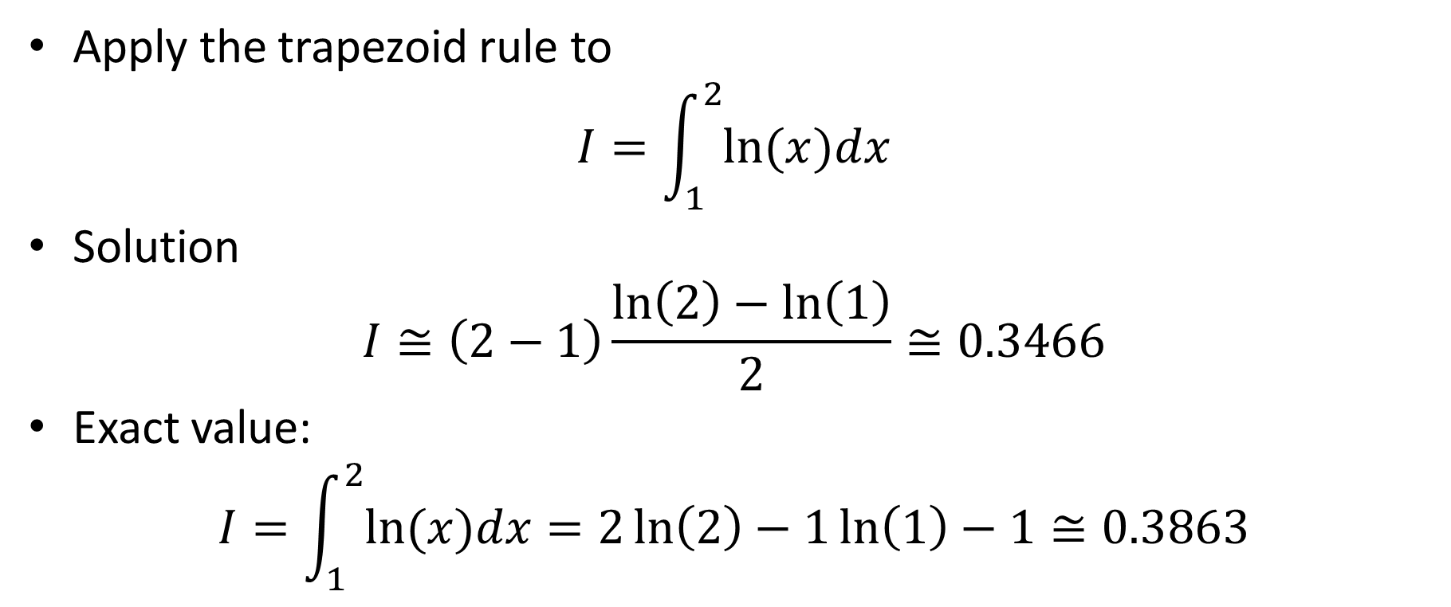
Example
Apply the trapezoid rule to
$$I=\int_{1}^{2}{ln⁡(x)dx}$$
Solution
$$I≅\left(2−1\right)\frac{\ln\left(2\right)−\ln\left(1\right)}{2}≅0.3466$$
Exact value:
$$I=\int_{1}^{2}{ln⁡(x)dx}=2\ln\left(2\right)−1\ln\left(1\right)−1≅0.3863$$
Notes:
Let us now apply our quadrature formula to an example
For this we compute the defined integral of the natural log function over the interval [1, 2]
Using the trapezoid rule we find 0.3466 if we keep four digits in our calculations
We can compare this approximation with the exact value 0.3863 we get by using calculus.
Note that both values are remarkably close
Note as well that at this stage we do not yet discuss how we can estimate the error or how many digits should be used in the calculations.
This discussion will follow in coming lectures

Slide 11

Summary
The trapezoid rule is the 2-point closed Newton-Cote formula
It writes as
$$\int_{a}^{b}{f(x)dx}≅\left(b−a\right)\frac{f\left(a\right)+f(b)}{2}$$
Notes:
Let us summarize the key points
- The trapezoid rule is the 2-point closed Newton-Cote formula
It writes as
$$\int_{a}^{b}{f(x)dx}≅\left(b−a\right)\frac{f\left(a\right)+f(b)}{2}$$

